Slide 1

Guidelines
Kindly use the given template for submitting your project (Make a copy of the template)
One team is only required to submit one project.
The ideal size of the presentation should not be more than 10 slides.
You are welcome to add as many POCs and design concepts to support your project.
The project should be feasible and the team members should be capable enough, to come up with the prototype of the same idea, if required.
Projects using Google developer technologies like Gemini APIs & building projects on IDX platform will earn additional points.
In case of queries, kindly reach out to us at solutionchallengesupport@hack2skill.com

Slide 2
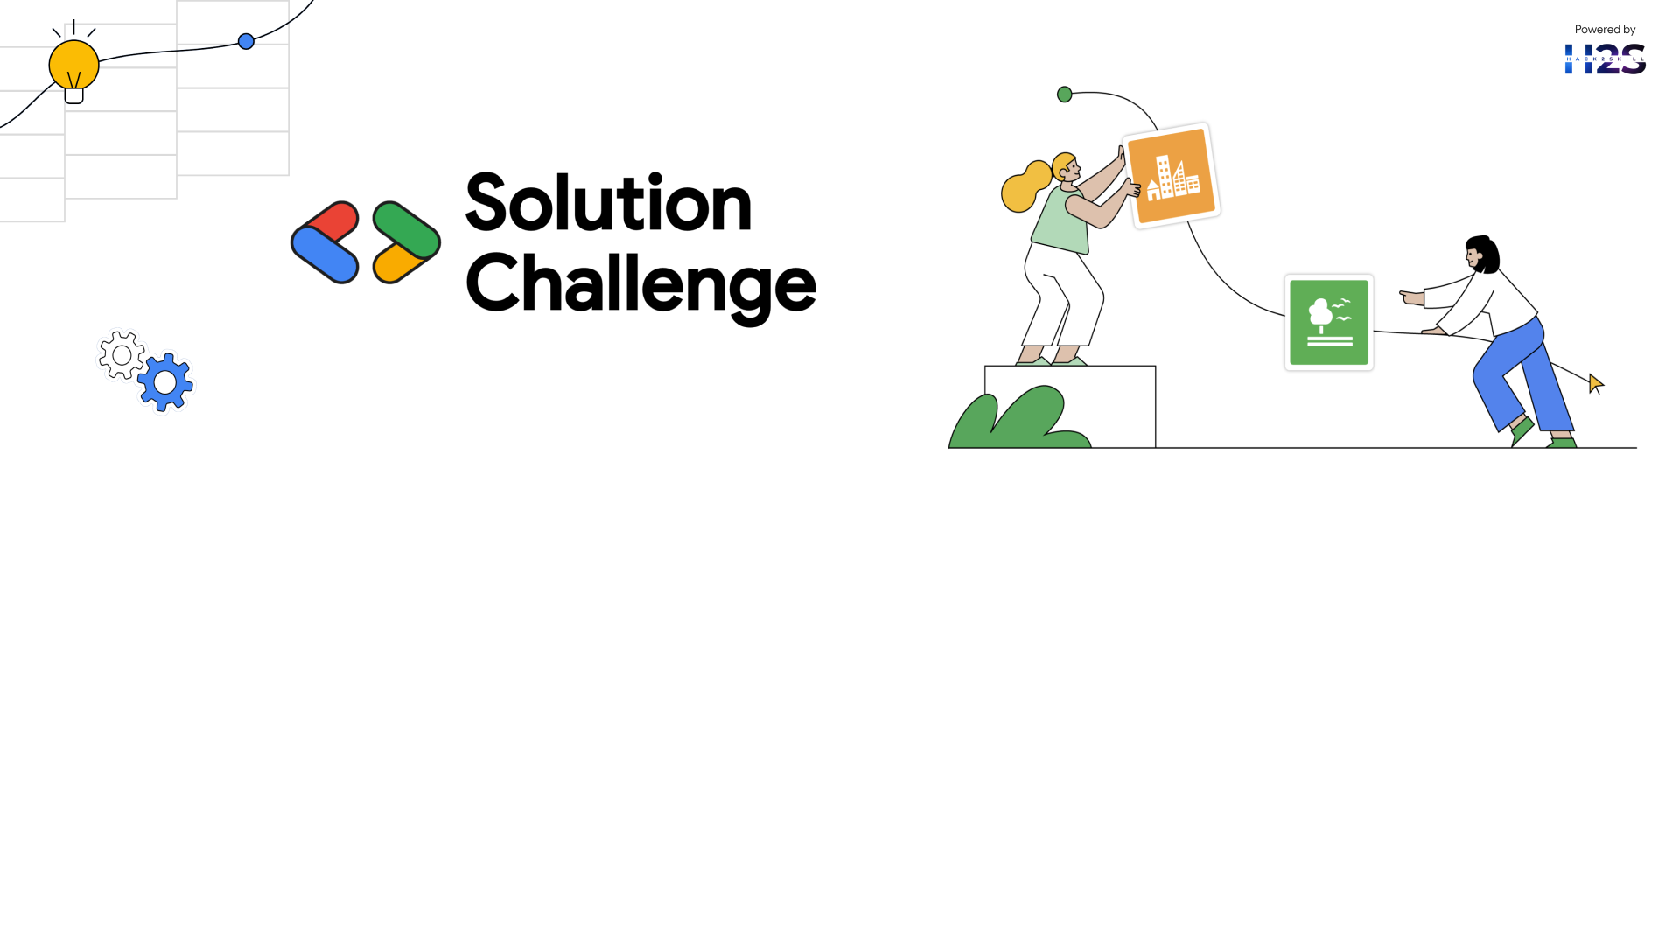
Team Details
Team name: DataDynamos
Team leader name: Akshat Saxena
Problem Statement: Revolutionizing Student Education with AI-
Generated Video Content

Slide 3
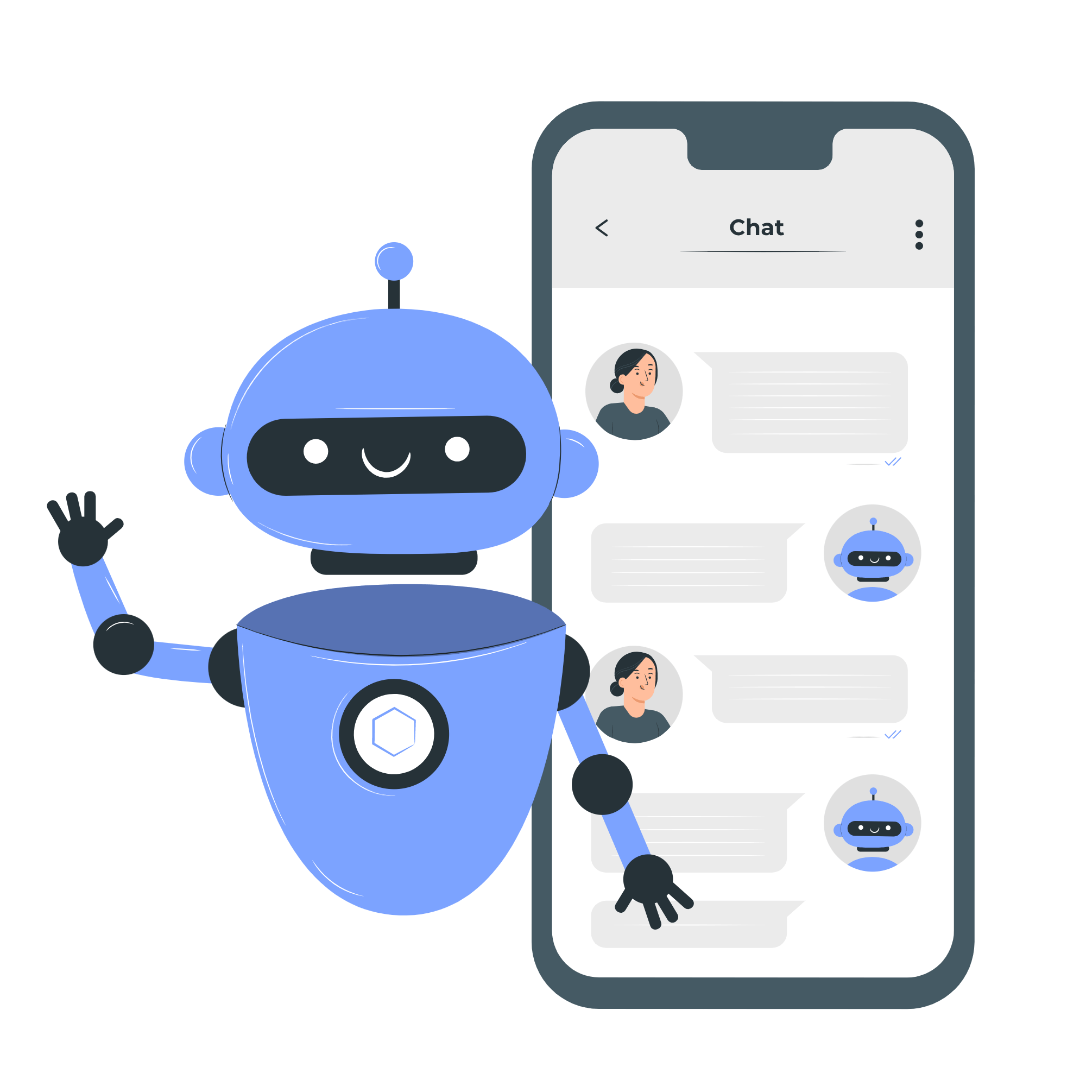
Brief about your solution
Our solution is an AI-powered platform that automates the generation of educational video content across various subjects like Visual Arts, Performing Arts, Coding, Financial Literacy, and Science.
Key Features of the Solution:
User Requests Content – Students interact with the system via TAPBuddy (WhatsApp Chatbot).
AI Processing with Gemini API –
(a)Text Generation: Gemini generates high-quality educational scripts.
(b)Image/Video Assistance:AI generates relevant visuals/animations.
Text-to-Speech Conversion – AI converts scripts into realistic voiceovers.
Video Generation & Hosting –
(a)IDX is used for development & deployment.
Video files are hosted on Google Cloud Storage.
(a)Delivery via TAPBuddy – The generated content is sent to students through WhatsApp.

Slide 4
Opportunities
1. How different is it from any of the other existing ideas?
Most existing solutions rely on manual content creation, making it time-consuming and expensive.
Our solution automates video script generation, voiceovers, and video creation using Gemini AI, reducing human effort.
Unlike typical educational videos, our system personalizes content based on student preferences and learning patterns.
2. How will it be able to solve the problem?
Scalability:- AI-driven automation makes it easier to create content for a larger audience without additional effort.
Personalized Learning:- Content is dynamically generated, ensuring it matches each student's learning speed and style.
Multi-Language Support:- Using Gemini API for translation and text-to-speech, we can deliver content in different languages, making education more inclusive.
3. Unique Selling Proposition (USP) of the Proposed Solution
AI-Generated Personalized Video Content – No need for human educators to create and edit videos manually.
Scalable & Cost-Effective – Content creation is fully automated, making high-quality education affordable.
Multi-Modal Learning – Combines text, voice, and video, ensuring higher engagement and retention.

Slide 5
List of features offered by the solution
AI-Powered Video Content Generation – Automatically creates educational videos using Gemini AI. Personalized Learning Experience – Customizes content based on the student's preferences and learning pace. WhatsApp Integration (TAPBuddy) – Students can access AI-generated lessons directly on WhatsApp, eliminating the need for extra apps. Text-to-Speech (TTS) Support – Converts scripts into natural-sounding voiceovers for better engagement. Multi-Language Support – Content can be generated in multiple languages, ensuring inclusivity.️
Google Cloud & IDX Deployment – Ensures scalability, faster development, and smooth deployment. AI-Generated Visuals & Animations – Uses AI to create diagrams, illustrations, and animations for better learning.
Automated Transcription & Summarization – Generates text summaries for quick revisions. Scalable & Cost-Effective – AI automation reduces manual effort, making high-quality education affordable. Multi-Subject Support – Covers Visual Arts, Performing Arts, Coding, Financial Literacy, and Science.

Slide 6
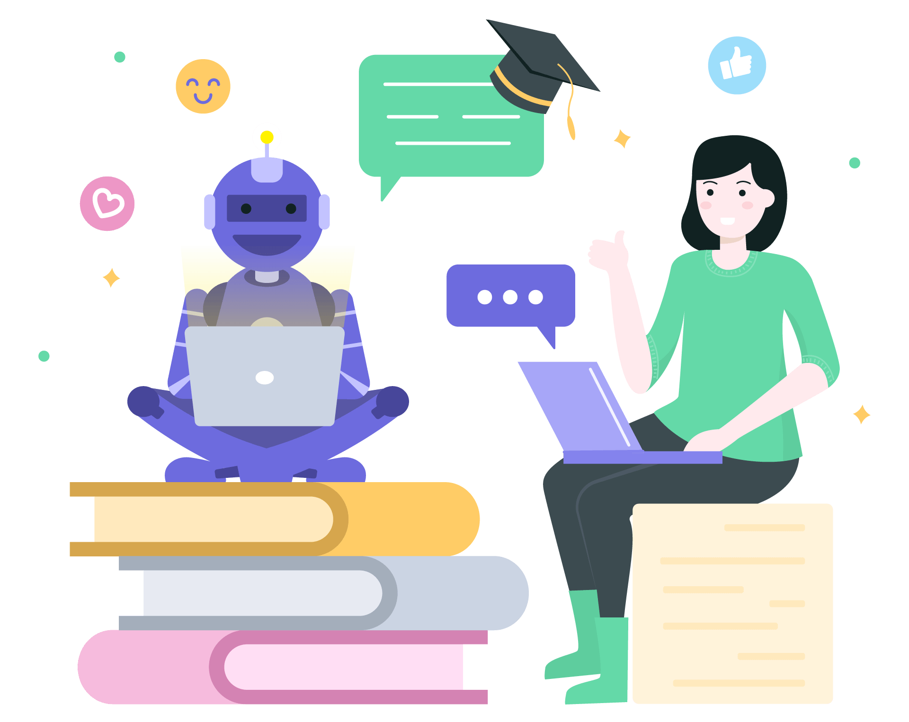
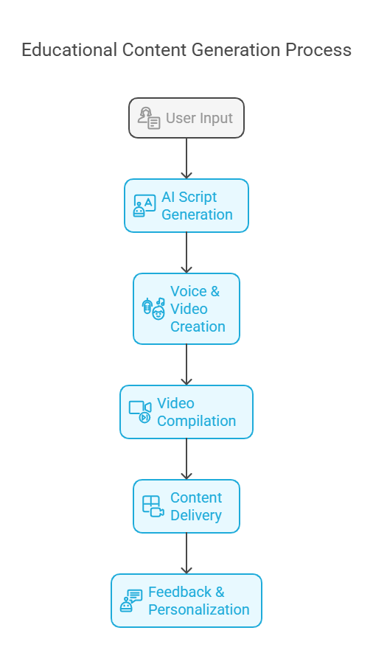
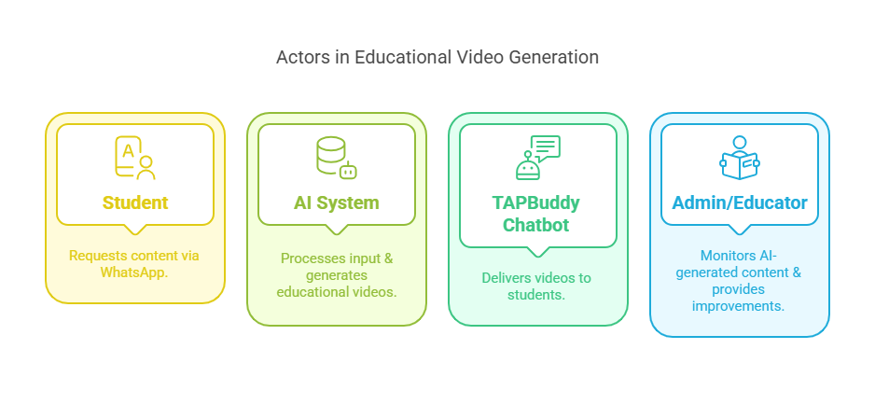
Process flow diagram or Use-case diagram

Slide 7
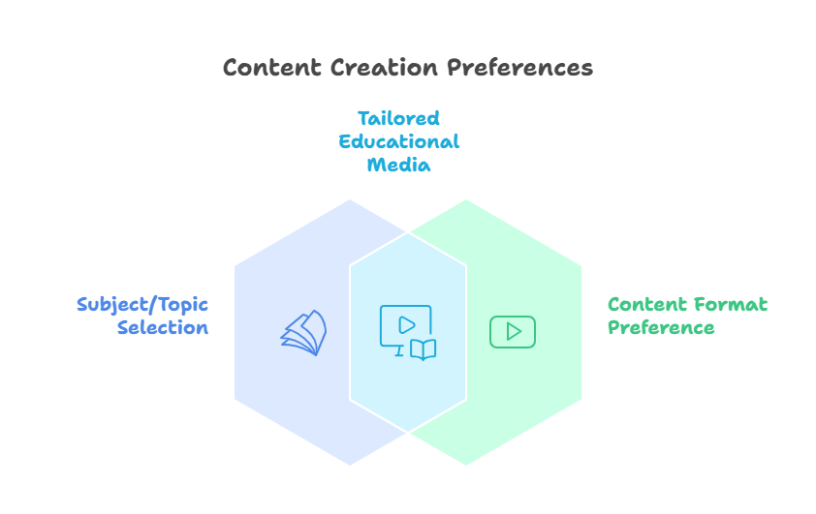
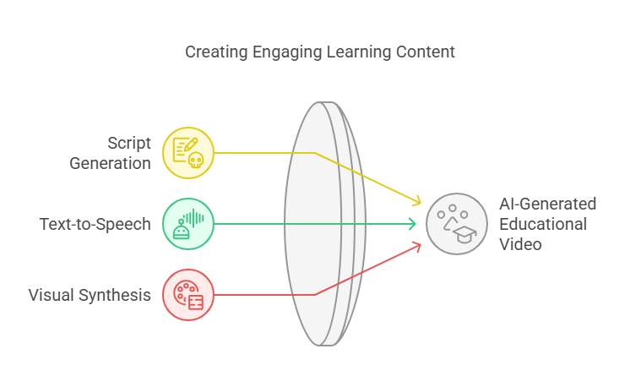
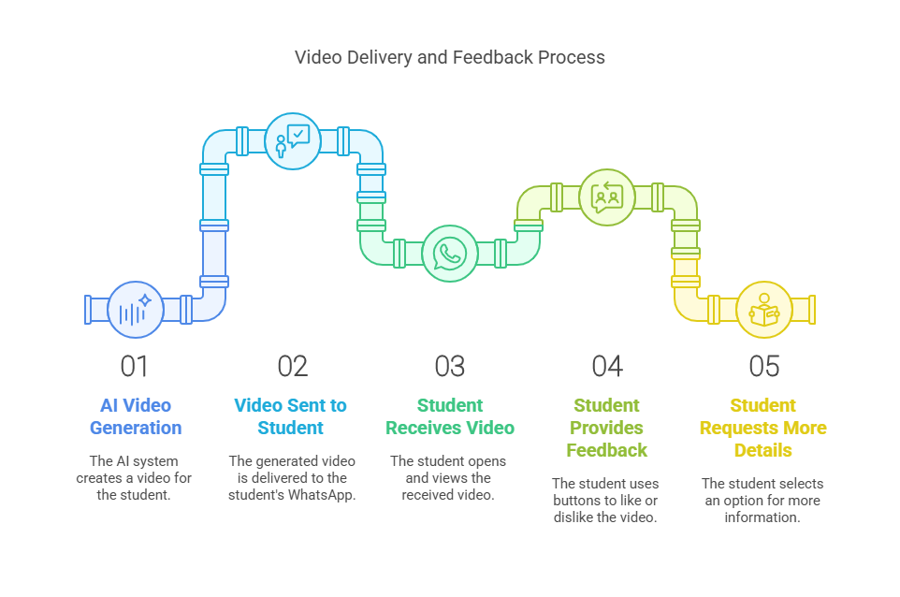
Wireframes/Mock diagrams of the proposed solution (optional)

Slide 8
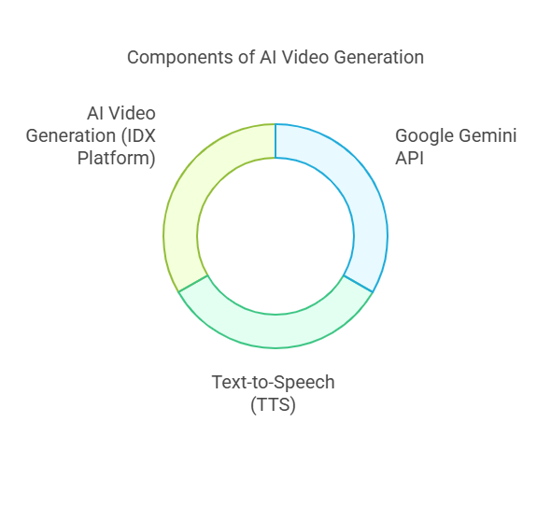
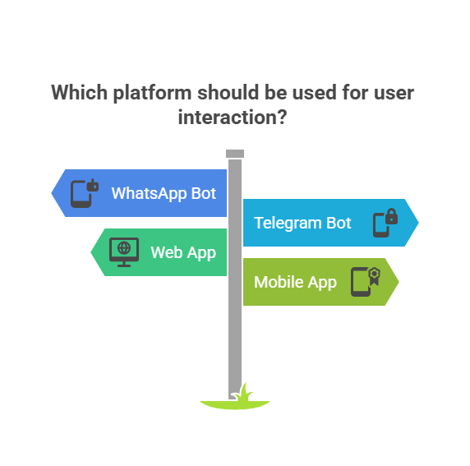
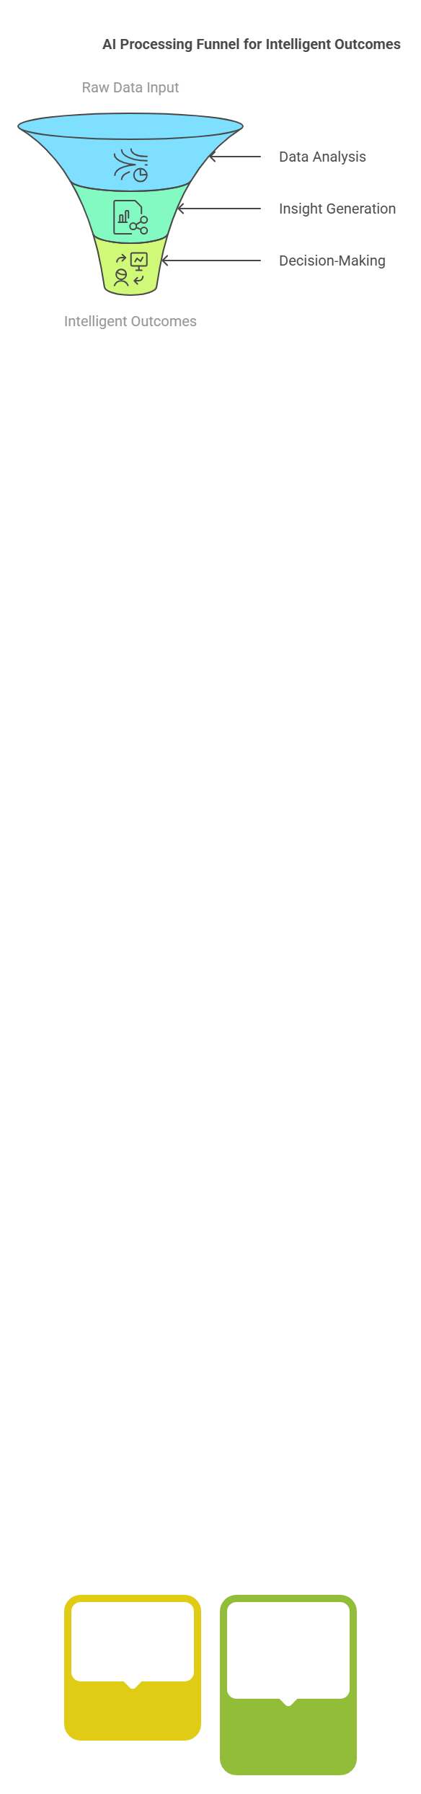
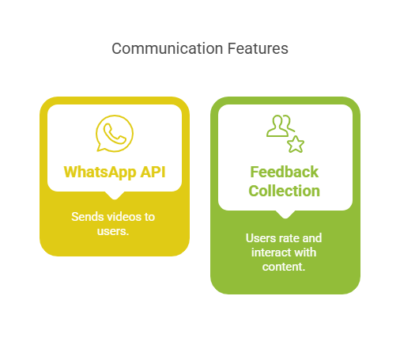
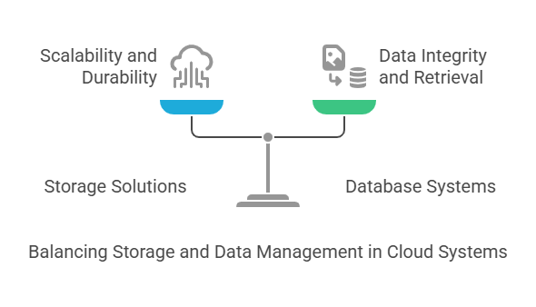
Architecture diagram of the proposed solution

Slide 9





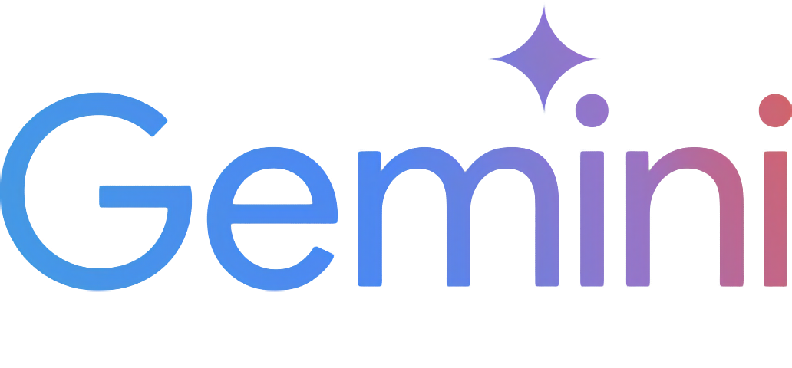
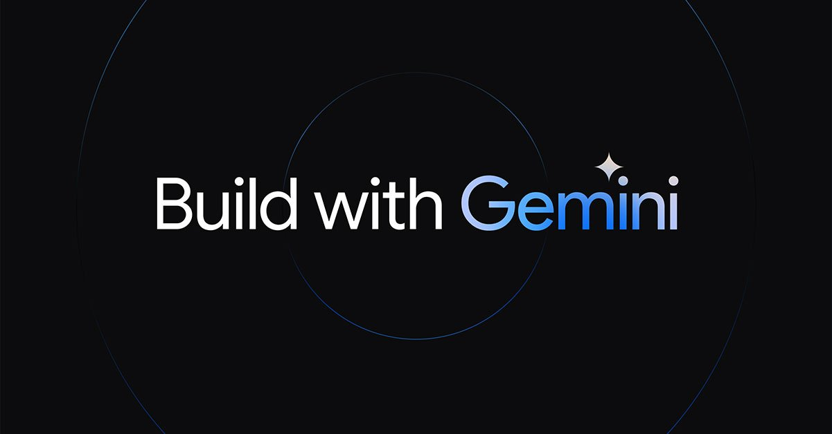
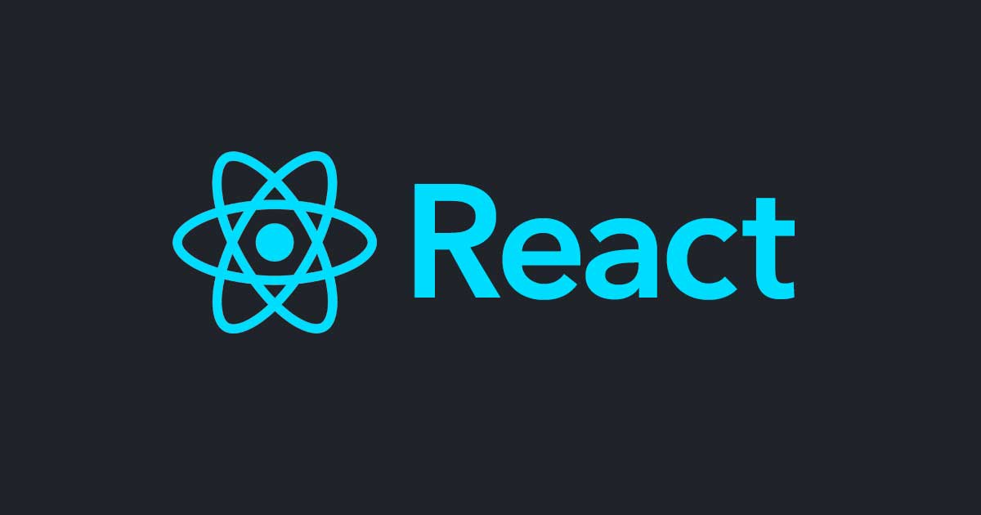
Technologies to be used in the solution
1. Gemini API – AI-powered scriptwriting, voiceover, and image generation. 2. Google Cloud & IDX – Seamless deployment and hosting of AI models. 3. React + Flask – Frontend (React) & backend (Flask) API for user interactions. 4. Firebase Storage – Stores and delivers AI-generated videos.
5. Node JS – For run app dynamically.
Flask

Slide 10
Estimated implementation cost
Cloud & API Costs:-
Google Gemini API: $20–$100/month (depends on API usage)
Google Cloud Storage: $10–$50/month (for video hosting)
2. Development Costs:-
Frontend (React/Next.js, Flutter): $2,000–$5,000 (if outsourced)
Backend (Node.js, Firebase, PostgreSQL): $3,000–$7,000
AI Integration (Gemini, IDX, TTS, Video Processing): $5,000+
3. Other Costs
Domain & Hosting: $50–$200/year
Marketing & Launch: $500–$2,000
Total Estimated Cost: $5,000 – $15,000+ (varies based on team size, cloud usage, and scale)

Slide 11
Provide links to your:
GitHub Public Repository
Demo Video Link (3 Minutes)
MVP Link

Slide 12
